Slide 1
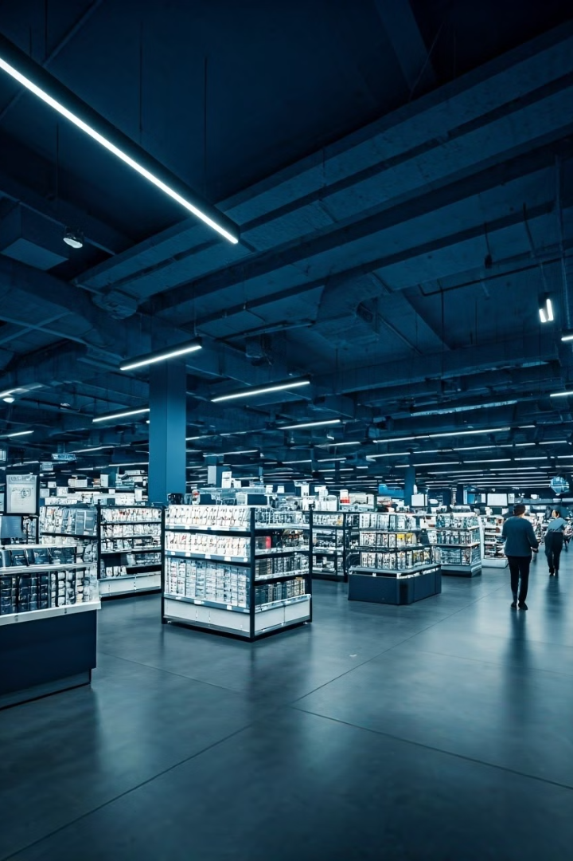
Global Superstore Sales and Profit Analysis (2011-2014)
This presentation provides a comprehensive analysis of the Global Superstore dataset, covering sales and profit information from 2011 to 2014. We'll examine regional performance, countries performance, product sub-categories, and trends to identify patterns and offer insights for strategic decision-making in the retail sector.
by Timothy Aluko
A

Slide 2

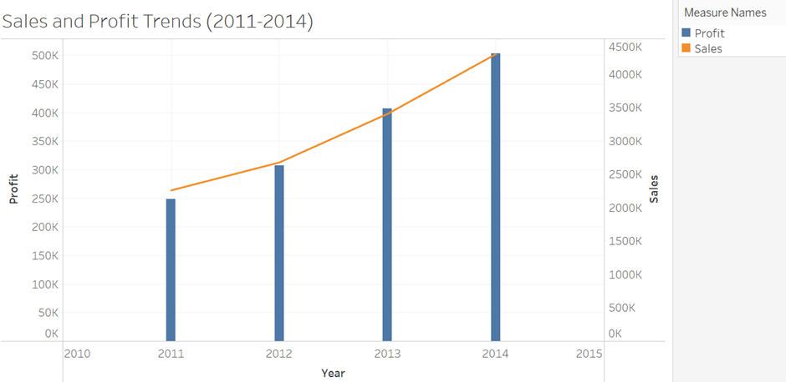
Sales and Profit Trends (2011-2014)
The initial year, 2011, lays the foundation for our analysis. We observe moderate sales and profit margins as the Global Superstore enters the market.
Sales and profit margins increase steadily during 2012-2013, reflecting growth strategies and improved efficiency.
2014 marks a culmination of efforts, with record-high sales and profits. We'll explore the factors contributing to this success.

Slide 3
Regional Performance Analysis
North America
Europe
Asia-Pacific
Analyze US and Canada performance, considering market saturation, consumer behavior, and economic conditions. Identify top-performing regions and potential expansion opportunities.
Examine the diverse European market, considering cultural differences, economies, and regulations. Highlight successful strategies and pinpoint challenges.
Explore rapidly growing markets in the region, focusing on China, India, and Australia. Analyze how the superstore adapts to local preferences and distribution networks.

Slide 4
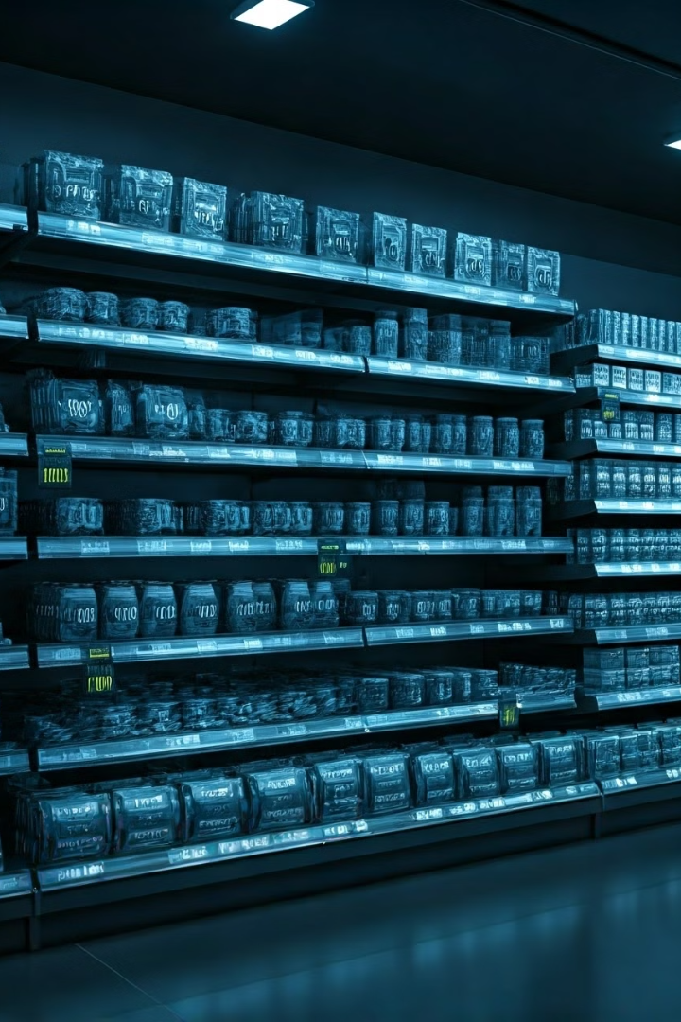
Product Category Performance
Technology
Analyze sales and profit trends for computers, phones, and electronics. Consider product life cycles, innovation, and competition.
Furniture
Examine performance of office furniture, home decor, and storage. Investigate seasonality, home improvement trends, and shipping costs.
Office Supplies
Assess sales patterns of stationery, organizational tools, and office essentials. Consider changing work environments and remote work.
Specialty Items
Explore niche categories with unique growth patterns or profit margins. Identify areas for expansion or products to phase out.

Slide 5
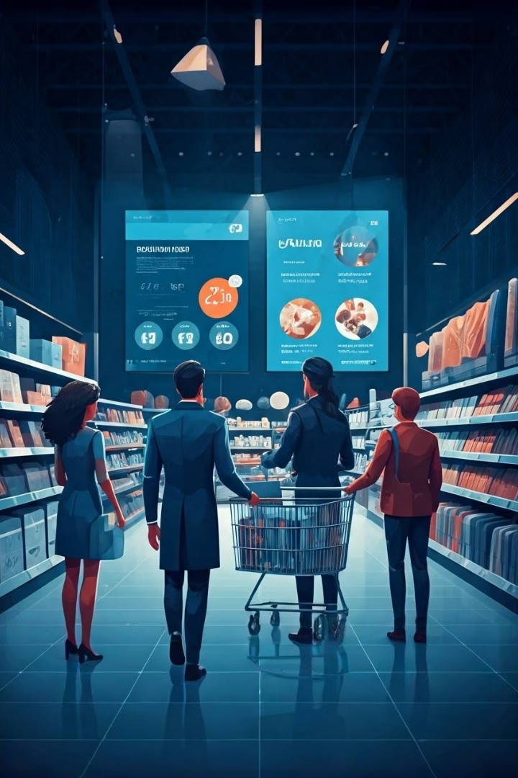



Customer Segment Analysis
Corporate
Analyze purchasing patterns of business clients, considering factors such as bulk orders, negotiated discounts, and long-term contracts. Examine how economic cycles and industry-specific trends impact corporate spending.
Consumer
Investigate individual consumer behavior, focusing on factors like seasonal shopping patterns, response to promotions, and brand loyalty. Consider demographic influences on purchasing decisions and lifetime customer value.
Home Office
Examine the unique needs of home-based businesses and remote workers. Analyze how this segment's purchasing behavior differs from traditional corporate clients and individual consumers, especially in light of changing work trends.

Slide 6

Profit Margin Analysis
Product Category
Average Profit Margin
Variability
Key Factors
Technology
15%
High
Rapid obsolescence, competitive pricing
Furniture
25%
Medium
Shipping costs, seasonal demand
Office Supplies
35%
Low
Stable demand, low storage costs
Specialty Items
40%
Very High
Niche markets, unique products

Slide 7




Shipping and Logistics Impact
Order Processing
Warehouse Operations
Transportation
Customer Receipt
Investigate shipping methods, costs, delivery times, and customer satisfaction.
Analyze efficiency, order accuracy, processing time, and inventory integration.
Examine inventory turnover, picking efficiency, and storage optimization.
Assess on-time delivery, product condition, and customer feedback.

Slide 8
Future Outlook and Recommendations
1
Embrace Digital Transformation
2
Sustainability Initiatives
Implement AI-driven inventory management, explore augmented reality for shopping.
Reduce environmental impact with optimized packaging, reverse logistics, and sustainable sourcing.
3
Personalization at Scale
4
Expand Omnichannel Presence
Personalize product recommendations and marketing using customer data. Implement a robust CRM system.
Integrate online and offline channels for a seamless shopping experience. Leverage physical stores as fulfillment centers and showrooms.

